Slide 1
GRAPH SIMILARITY

Slide 2
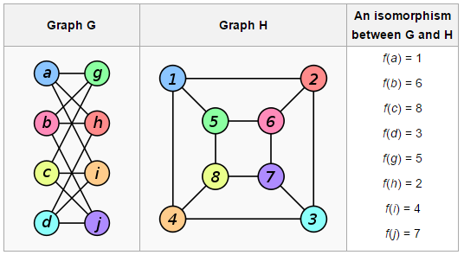
Graph ISOMORPHISM
A graph G is said to be isomorphic to Graph H if there is a one to one mapping from the vertices in graph G to the vertices in graph H.
Graph isomorphism is NP, but not known to be in P or NP-complete
Graphs whose isomorphism can be solved in polynomial time
Trees
Planar graphs
Interval graphs
Graphs with bounded degree

Slide 3
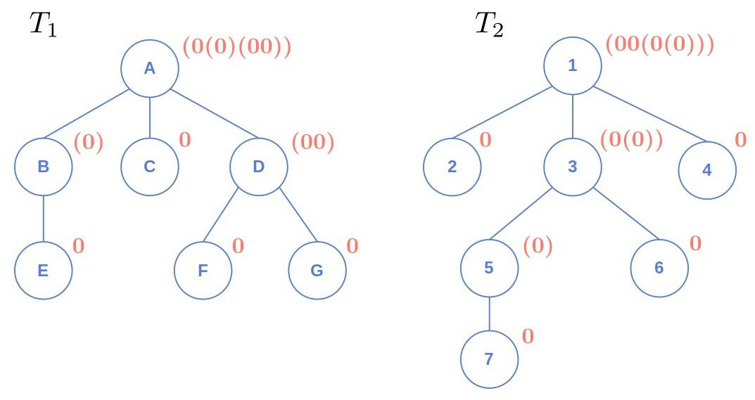
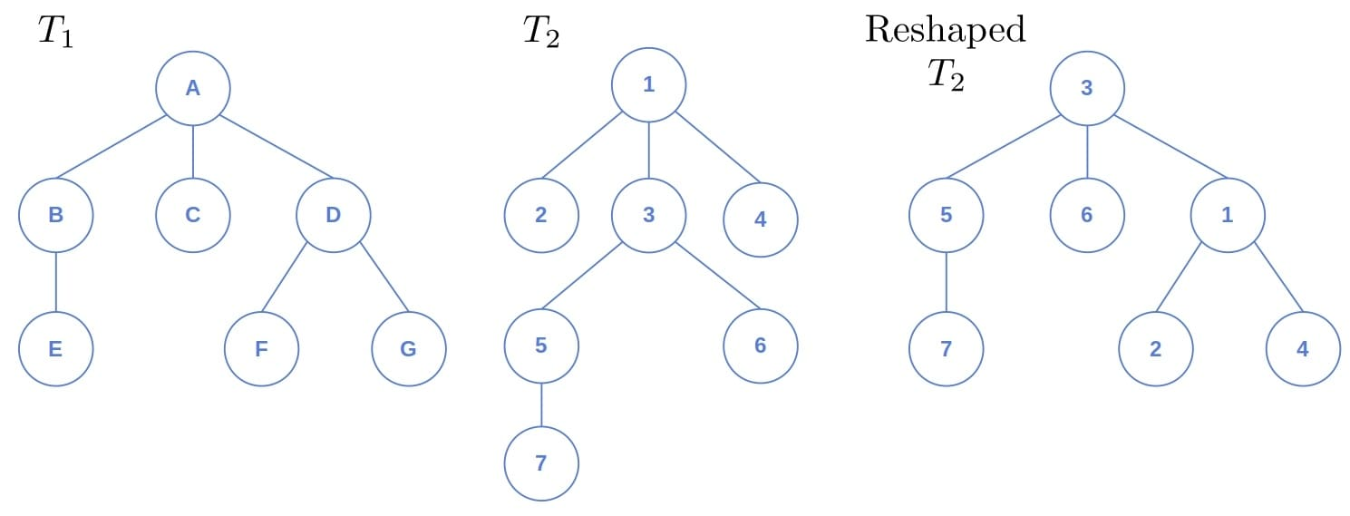
ISOMORPHISM FOR TREES
1. Find the center(s) of the trees
2. Root the trees at the centers
3. If every level has the same degree distribution, then the trees are isomorphic
4. We can check using AHU (Aho, Hopcroft Ullman) coding
Each leaf is marked with 0
Each non leaf is marked as ( AHU of its children in non-descending order of length )
Non descending order is important to match the codes for comparing trees

Slide 4
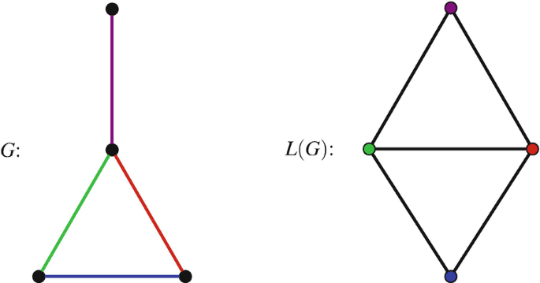
Line Graphs and ISOMORPHISM
A line graph L(G) of a given graph G (V,E) is created as follows;
Each edge of G is a vertex in the line graph. Two vertices in L(G), i.e. edges in G, are connected if they share a common vertex in G.
Whitney graph isomorphism theorem:
Two connected graphs are isomorphic if and only if their line graphs are isomorphic,
Exceptions K3 and K1,3
Would creating the line graph or a line graph give back the original graphs ?

Slide 5
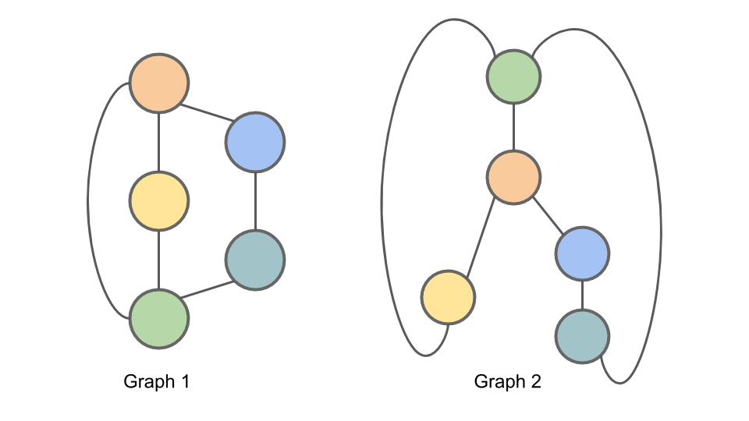
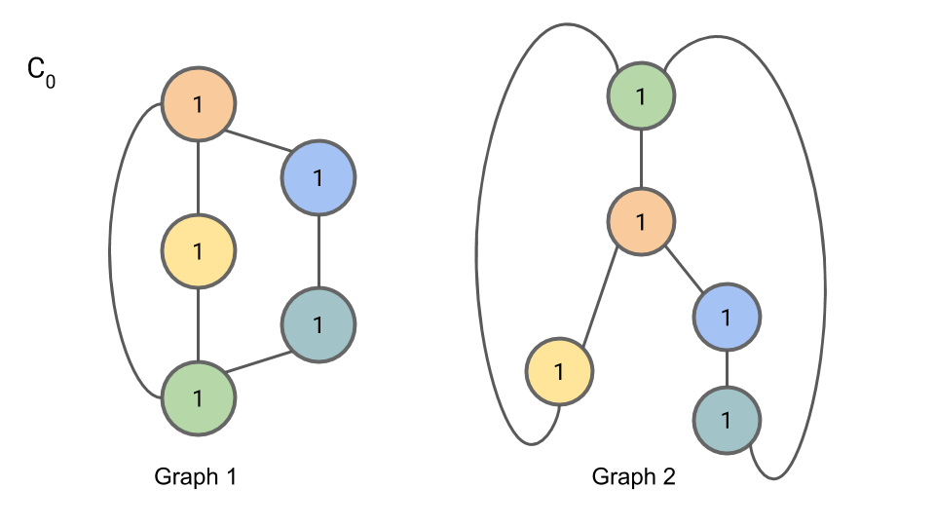
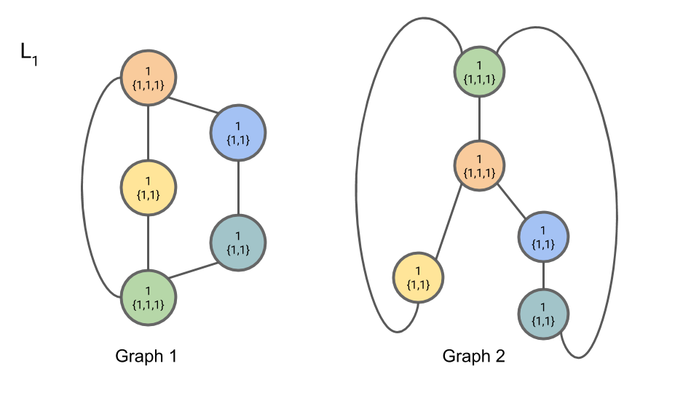



weisfeiler-lehman IsoMORPHISM TEST
Initialize, C0; n=1 for all nodes n.
At iteration i
For each node n, Set Li,n to be a tuple containing the node’s old label Ci−1,n and the multiset of compressed node labels Ci−1,m from all nodes m neighboring n from the previous iteration (i−1).
Complete iteration i by setting Ci,n to be a new “compressed” label. Any two nodes with the same labels Li,n must get the same compressed label Ci,n.
Partition the nodes in the graph by their compressed label. Repeat 2 + 3 for up to N (the number of nodes) iterations, or until there is no change in the partition.

Slide 6
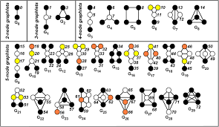
Motifs and Orbits
An automorphism of a graph is a form of symmetry in which the graph is mapped onto itself while preserving the edge–vertex connectivity.
Two vertices belong to the same orbit if and only if there exists an automorphism that takes one to the other
Two vertices with the same orbit are structurally similar

Slide 7
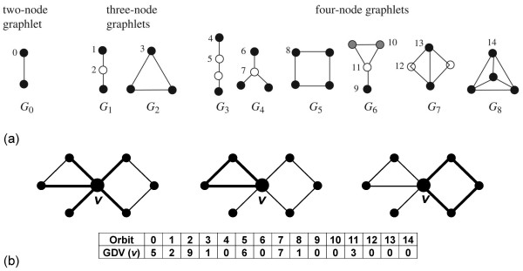
Graphlet Degree Vector
Vector enumerating the different orbits that a vertex belongs to
Vertices having similar graphlet degree vector are structurally similar.

